Slide 1
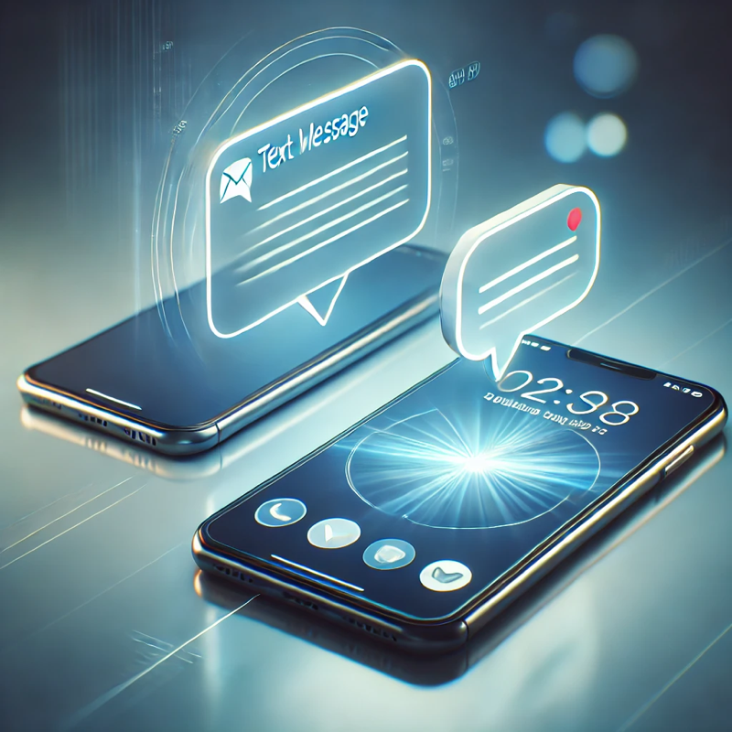
Let’s get started!
Turn and Talk
When you send a message to a friend, how does your phone make sure the message goes to the right person and not someone else?
Notes:
Students pick up a laptop

Slide 2
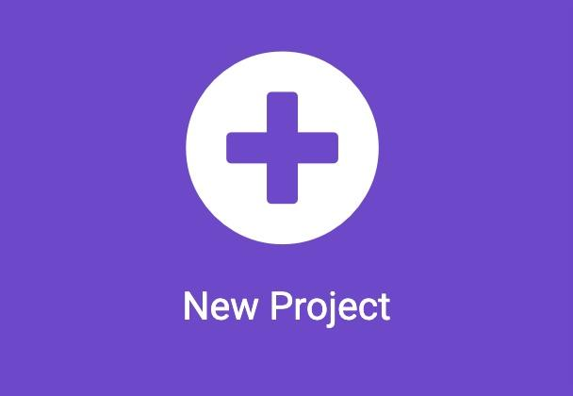
Let’s get started!
On your own
In your browser, type the following address: makecode.microbit.org
Start a new project
Use meaningful name!
Good example: Sending text message
Bad example: Project 1

Slide 3
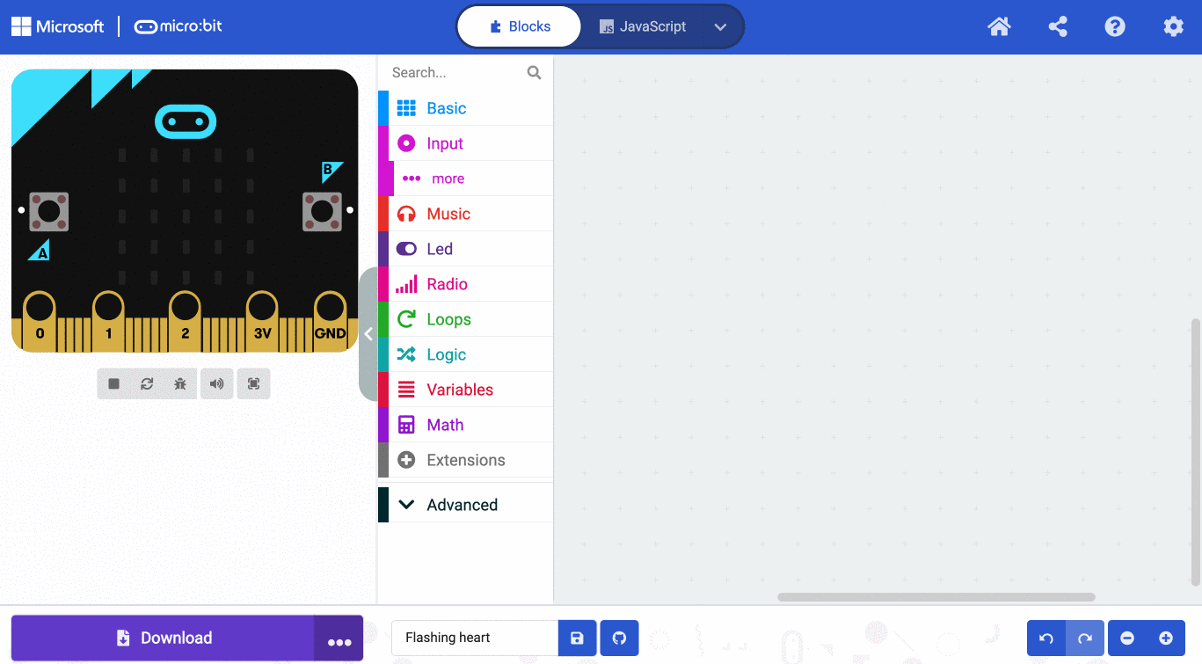
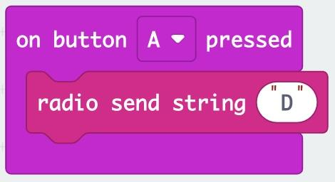
Use radio channels to communicate
Use on button pressed to send a text message over radio with radio send string.
Type your name’s initial on the radio send string block

Slide 4
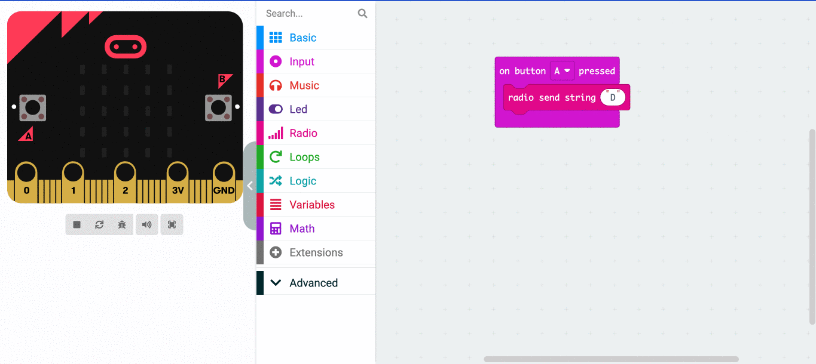
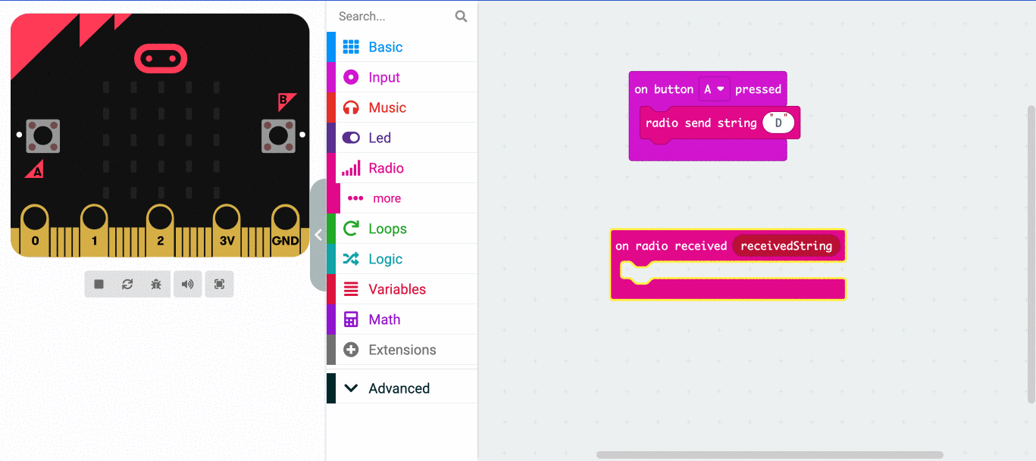
Use radio channels to communicate
1. Add a on received string block to run when a message is received.
2. Add a show string to display the string on the screen. Pull the receivedString out of on received string and put it into show string.

Slide 5
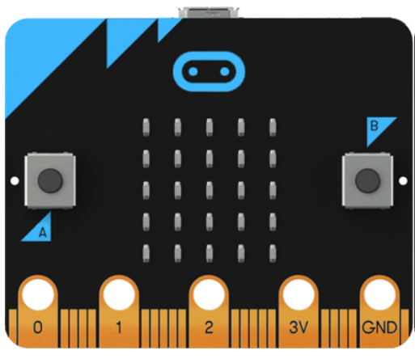
Create your own animation
Connect your micro:bit to the computer
Download the program
Disconnect the micro:bit from the computer.
When everyone is ready, Press the A button
What happened?

Slide 6
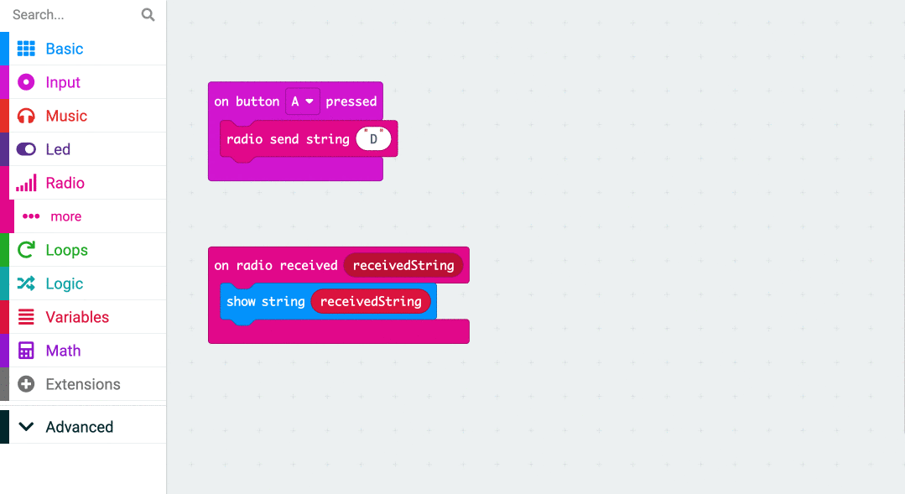
Use radio channels to communicate
Add a on start block on the coding space.
Put a radio set group block inside the on start block to set a radio channel.
Click the number inside the radio set group block and set it to 1.
Download the program again into your micro:bit.
Press the A button now.
What happened?

Slide 7
Use radio channels to communicate
With your partner
Pick a number for your radio channel by choosing any number between 2 and 255 (don’t use 1, since everyone was using that before).
You and your friend must pick the same number to talk to each other.
Click the number inside the radio set group block and change it to the number you picked.

Slide 8
Use radio channels to communicate
With your group
Can you imagine if this happened when you sent a text message to a friend?
What would be the problem if everyone could see every message you sent?
Let’s fix this!

